Slide 1

Power Bi Project
on
Insurance and Claim Analysis
Presented by : RAVINDRA NADH
Batch no : 403
INNOMATICS RESEARCH LABS
DISUKHNAGAR BRANCH

Slide 2

What is Insurance?
A financial protection system where customers pay premiums to cover losses from accidents, illness, or damage.
Money from many is pooled so claims can be paid to the few who face losses.
What is a Claim?
A request made by a policyholder to get compensation for a covered event (like a car accident or health issue).
The insurer verifies the claim and pays if it meets policy terms.

Slide 3
How Insurers Earn Profit
Collect premiums from customers.
Pay valid claims and invest remaining funds.
Profit = Premiums + Investments – Claims – Costs.
Maintain balance through risk analysis, pricing, and fraud checks.
Claim Process
Customer reports incident.
Submits claim form & documents.
Insurer reviews & investigates.
Coverage verified.
Payment processed & claim closed.

Slide 4
Problem statement:
Insurance companies often struggle to efficiently track claim patterns, identify high-risk customers, and manage unpredictable claim costs due to scattered and complex data. This makes it challenging to quickly spot trends, control losses, and respond to real-world issues like fraud or costly payouts. A streamlined approach is needed to unify customer, vehicle, and claims data for clear, actionable insights that improve decision-making.
Objective:
The main objective of this project is to build an interactive Power BI dashboard that analyzes insurance customer and claims data to uncover key trends, risk factors, and high-impact segments. The dashboard will help managers instantly visualize claim amounts, frequency, and customer patterns, enabling better risk management, faster business decisions, and improved company profitability.

Slide 5
Data set description
ID: Unique number to identify each customer or case
BirthDate: The date the customer was born (used to find their age)
Car Color: The color of the customer’s car
Car Make: The brand or company that made the car (like Ford, Nissan)
Car Model: The specific type or name of the car
Car Use: Shows if the car is used for personal (Private) or business (Commercial) purposes
Car Year: The year the car was made
Coverage Zone: The area where the car is mainly used (urban, rural, suburb, etc.)
Education: The highest education level of the customer (High School, Bachelors, etc.)
Gender: Whether the customer is male or female
Marital Status: Current relationship status (Single, Married, Divorced...)
Parent: Whether the customer has children (Yes/No)
Claim Amount: Total amount of money claimed by the customer
Claim Freq: How many times the customer has filed an insurance claim
Household Income: The total income for the customer’s household
Kids Driving: Number of kids in the household who drive

Slide 6
Data Cleaning :
Removed duplicate records and fixed missing values for accuracy
Standardized BirthDate, car details, and text formats
Checked for and handled outliers in claim amounts and household incomes
Created new columns (Age, Car Age) from existing data
Ensured all data types were set correctly for analysis

Slide 7
Measures and DAX :
Total Claims Amount: Adds up all claim payouts
Average Claim Amount: Finds the typical claim value
Total Policies: Counts unique insurance records
Claim Frequency: Calculates average number of claims per customer
Claims by Category:Sums claims by selected group
Customer Age: Finds policyholder age
Car Age: Finds vehicle age
Male Count:Counts male customers
Female Count: Counts female customers

Slide 8
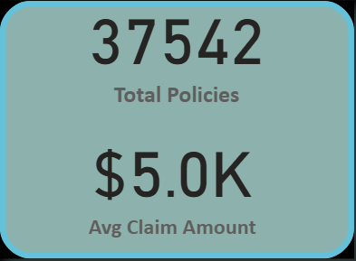
Visualizations:
How many policies are active, and what is the average claim amount?
Insights:
Total active policies stand at 37,542, showing a strong customer base.
The average claim amount is $5K, indicating moderate claim severity.
Claims appear manageable and consistent, supporting good risk control.
Recommendation:
The company should focus on customer retention and cross-selling within this large policy base while maintaining claim costs around the $5K mark through fraud detection, preventive safety programs, and regular policy reviews to preserve profitability.

Slide 9
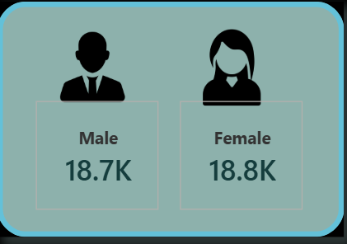
What is the gender distribution of policyholders?
Insights:
Male (18.7K) and Female (18.8K) — balanced customer base.
Equal risk exposure across genders.
Chance to analyze gender-wise claim behavior for better pricing.
Recommendation:
The company should conduct a detailed gender-based claims analysis to identify differences in claim frequency, amount, or type. Based on the results, it can create personalized insurance packages or premium adjustments that reward lower-risk groups and improve overall profitability.

Slide 10
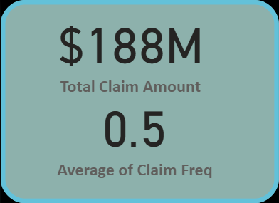
What is the total claim amount and how frequently are claims made?
Insights:
Total claim amount: $188M — indicates substantial payout volume.
Average claim frequency: 0.5 — about one claim for every two policies.
Suggests a moderate claim rate and effective risk management.
Recommendation:
The insurer should analyze claim frequency by customer segment or region to identify high-risk areas. Introducing preventive measures, usage-based pricing, and safety awareness programs can help lower claim frequency and protect profit margins.

Slide 11
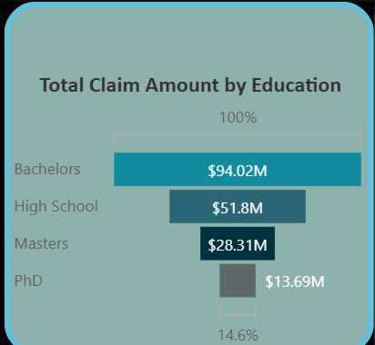
How does the total claim amount vary by education level?
Insights:
Bachelor’s holders have the highest claim amount at $94.02M.
Claim amounts decrease as education level increases.
PhD holders show the lowest total claim amount ($13.69M), suggesting lower risk.
Recommendation:
The company should leverage education as a risk factor in pricing strategies. Offering premium discounts or loyalty rewards to highly educated customers (who show lower claim trends) can improve retention of low-risk clients and enhance profitability.

Slide 12
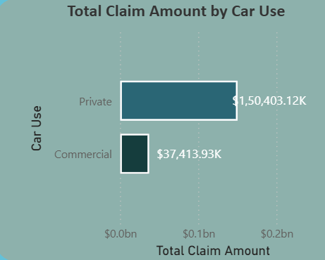
How does the total claim amount differ between private and commercial car use?
Insights:
Private vehicles account for the majority of claims — $150.4M.
Commercial vehicles contribute significantly less — $37.4M.
Indicates higher claim volume from personal usage due to greater policy count.
Recommendation:
The company should review claim frequency and severity for private vs. commercial vehicles. Introducing usage-based insurance and driver safety programs for private users can help reduce frequent claims, while optimizing premium pricing for commercial fleets based on mileage and risk exposure.

Slide 13
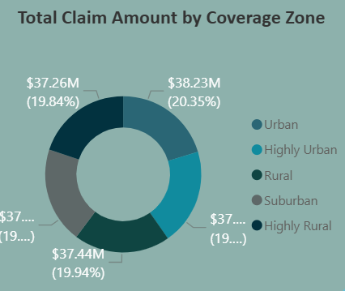
How does the total claim amount vary across different coverage zones?
Insights:
Urban and Highly urban zones show the highest claim amount — $38.23M (20.35%).
Highly rural, rural, and suburban zones have nearly equal claim shares (~19–20%).
Claims are fairly distributed, but slightly higher in densely populated areas.
Recommendation:
The company should implement region-based pricing and risk models, charging slightly higher premiums in urban and highly urban zones where claim frequency and severity are higher, while offering discounts or incentives in rural areas to attract more low-risk customers.

Slide 14
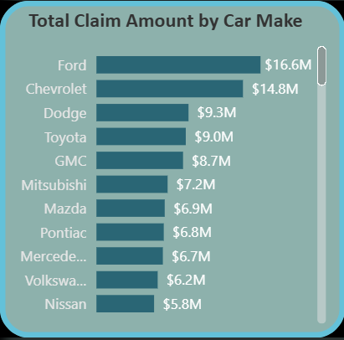
Which car makes have the highest total claim amounts?
Insights:
Ford leads with the highest claim amount — $16.6M.
Chevrolet follows closely at $14.8M, showing similar risk exposure.
Luxury brands like Mercedes and Volkswagen show lower total claims, likely due to fewer policyholders.
Recommendation:
The insurer should analyze claim frequency and repair costs by car make to identify high-risk or high-cost brands. Adjusting premium rates or offering brand-specific maintenance tie-ups can help reduce claim payouts and improve overall profitability.

Slide 15
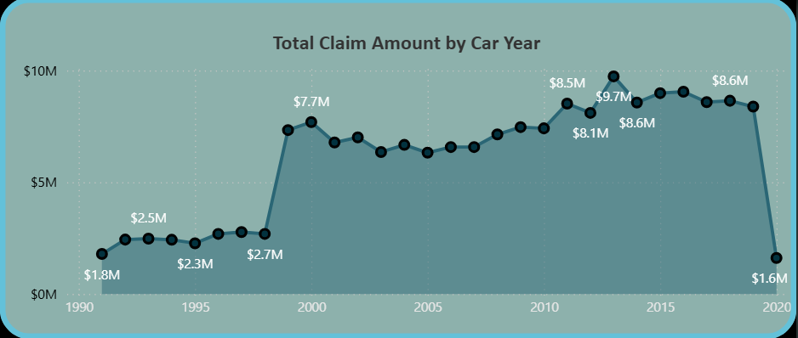
How does the total claim amount change across different car manufacturing years?
Insights:
Claims increased sharply around the year 2000, peaking at $7.7M.
2010–2018 cars show the highest claim range ($8M–$9.7M).
Claims drop significantly after 2020, likely due to fewer new claims or reduced usage.
Recommendation:
The company should analyze claim frequency and repair cost by vehicle age. Introduce age-based pricing models — offering lower premiums for newer cars with modern safety features and adjusting rates for older vehicles that show higher repair or maintenance claims.

Slide 16
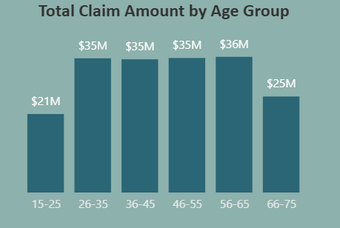
Which age group contributes the most to total claim amounts?
Insights:
Ages 56–65 have the highest total claims at $36M.
Middle-aged groups (26–55) maintain steady claim levels around $35M.
Young drivers (15–25) have the lowest total claims ($21M), likely fewer policyholders.
Recommendation:
The insurer should develop age-specific insurance plans — offer safe-driver incentives for middle-aged groups (high claim contributors) and affordable starter policies for young drivers to attract new customers while maintaining risk control.

Slide 17
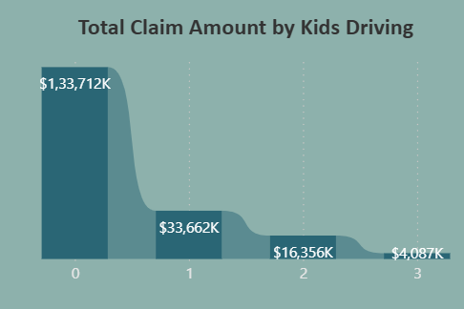
How does the total claim amount vary with the number of kids driving in a household?
Insights:
Households with no kids driving have the highest claim amount — $133.7K.
Claim amounts decrease sharply as the number of kids driving increases.
Families with more kids driving (2–3) show much lower total claims.
Recommendation:
The insurer should analyze family driving behavior and risk exposure to understand this trend. If households with multiple young drivers truly pose lower risk, the company can introduce family-based “safe driver” discounts or bundled insurance plans to attract and retain low-risk family customers.

Slide 18
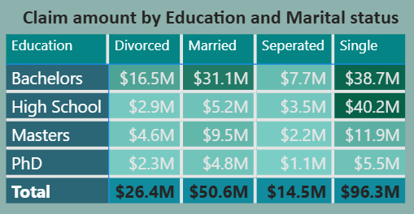
How do claim amounts differ by education level and marital status?
Insights:
Single policyholders have the highest total claim amount — $96.3M.
Married individuals follow with $50.6M, showing moderate claim activity.
Bachelor’s degree holders dominate across all marital categories in total claims.
Recommendation:
The company should analyze claim frequency and severity among single customers to identify risk factors. Tailor pricing models and engagement programs for singles, while promoting family and loyalty discounts for married customers, encouraging retention of lower-risk profiles.

Slide 19
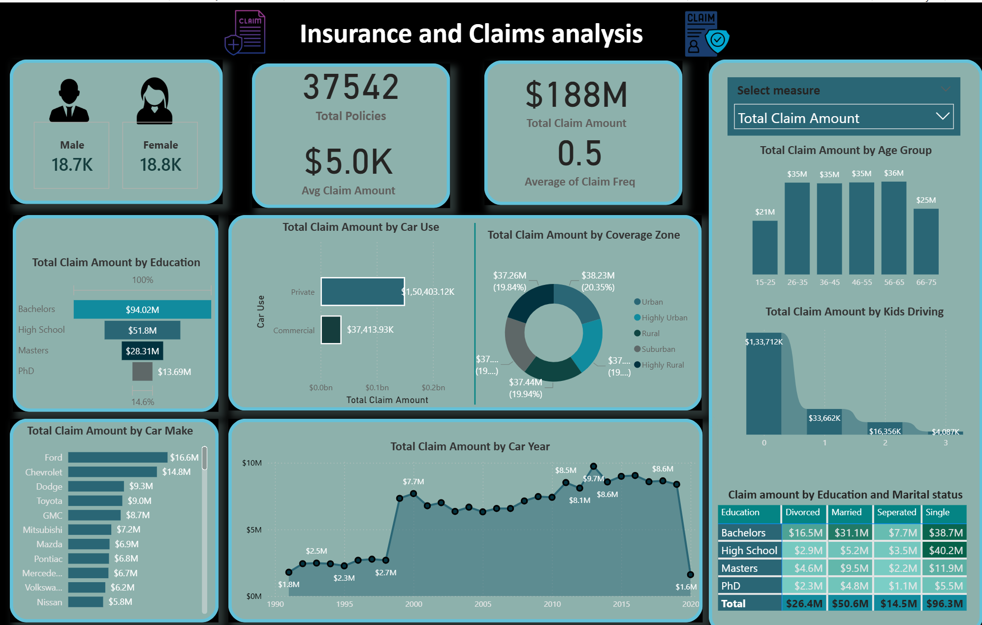

Slide 20
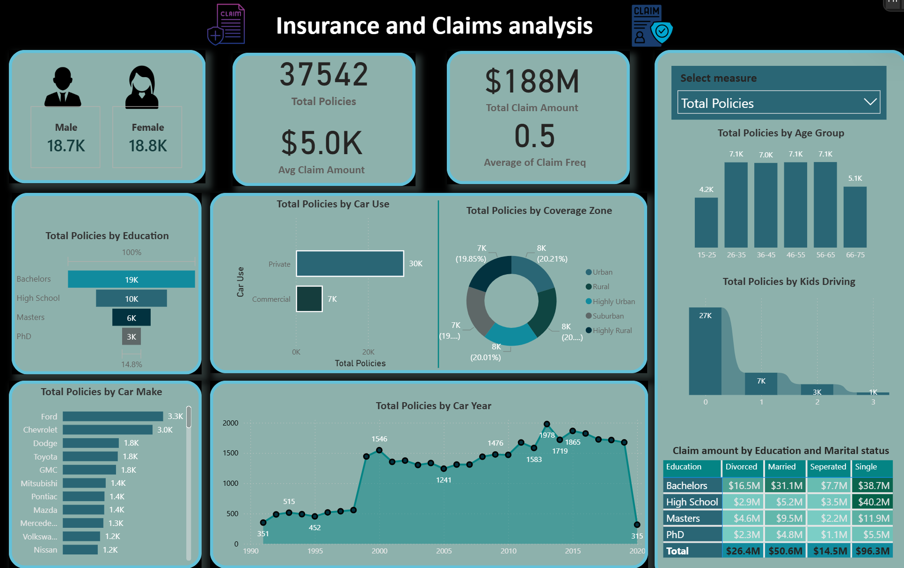

Slide 21
Main Business Insights :
The company holds a strong portfolio of 37K+ policies with a moderate average claim of $5K, reflecting healthy operations.
Balanced gender distribution ensures equal market coverage and risk spread.
Middle-aged customers (56–65) and Bachelor’s degree holders generate the highest claim amounts, showing key customer concentration.
Private car users and urban residents drive most claims, indicating high exposure zones.
Single individuals and older vehicles (2010–2018) show elevated claim patterns, while newer cars record minimal claims — a sign of improved safety and reduced risk.

Slide 22
Conclusion :
The insurer demonstrates strong growth and controlled risk, but claims are concentrated in specific customer and regional segments.
To enhance profitability and sustainability, the company should:
Implement risk-based dynamic pricing by age, education, and region.
Focus on urban and private-use vehicle segments with safety awareness and premium optimization.
Introduce personalized policies and loyalty rewards for low-risk groups (educated, married, rural customers).
Leverage predictive analytics to forecast claim trends and strengthen underwriting decisions.
Result: A smarter, data-driven insurance model that balances growth, customer satisfaction, and long-term profitability.

Slide 23


